Slide 1
Week 10 Presentation
By J. Jedediah Smith

Slide 2
What was tried?
Reach out to Rob about previous programs.
Investigate ONT data.
Try to my other two programs to work.
CCMetagen
Install RefSeq database
Try to classify some test data
BugSeq
Send them our long-read data to process
Review the results

Slide 3
How did it go?
Rob has not yet replied.
Most appropriate to treat ONT data as long-read.
Slightly more success with this set of programs.
CCMetagen: The setup has you download the reference data using wget instead of program commands. I was able to get this to work, but for some reason could not get it to run on a cluster to continue even if I disconnect. Problem because it is a large file (~100 GB)!
BugSeq: I uploaded our long-read ONT data to their website. Within 6 hours I was emailed a link to a detailed interactive analysis of the classification. It did both assembled and raw reads. It saved the data in several formats: csv, kreport, and even an interactive HTML report with Krona.

Slide 4
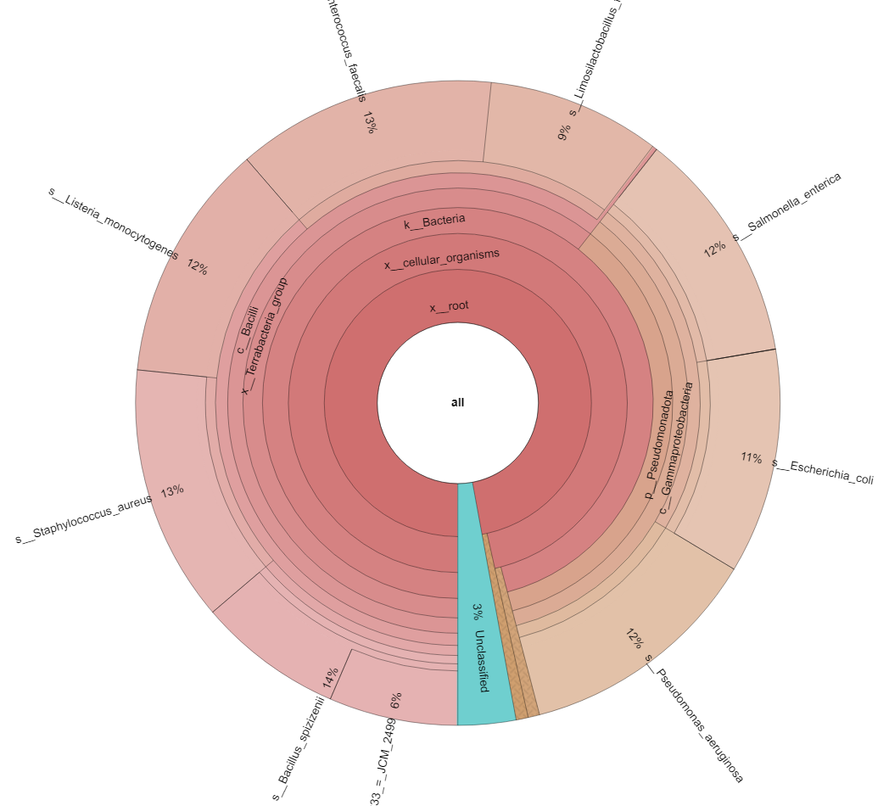
BugSeq Results
Very user friendly
Built-in QC report
Assembles contigs to compare with reads
Long-read w/ contigs radar chart to the right
Theoretically our ‘best’ contender
Very high species classification rate!

Slide 5
Where to go next?
Follow-up with Rob to get other programs running.
It seems like I’m not able to access the cluster?
Once other programs work, can compare to BugSeq.
Get ahold of answer key abundance estimates.
BugSeq is a very powerful, easy-to-use tool that handles long-read QC, assembly, and classification. It is free for academic use.

